Slide 1
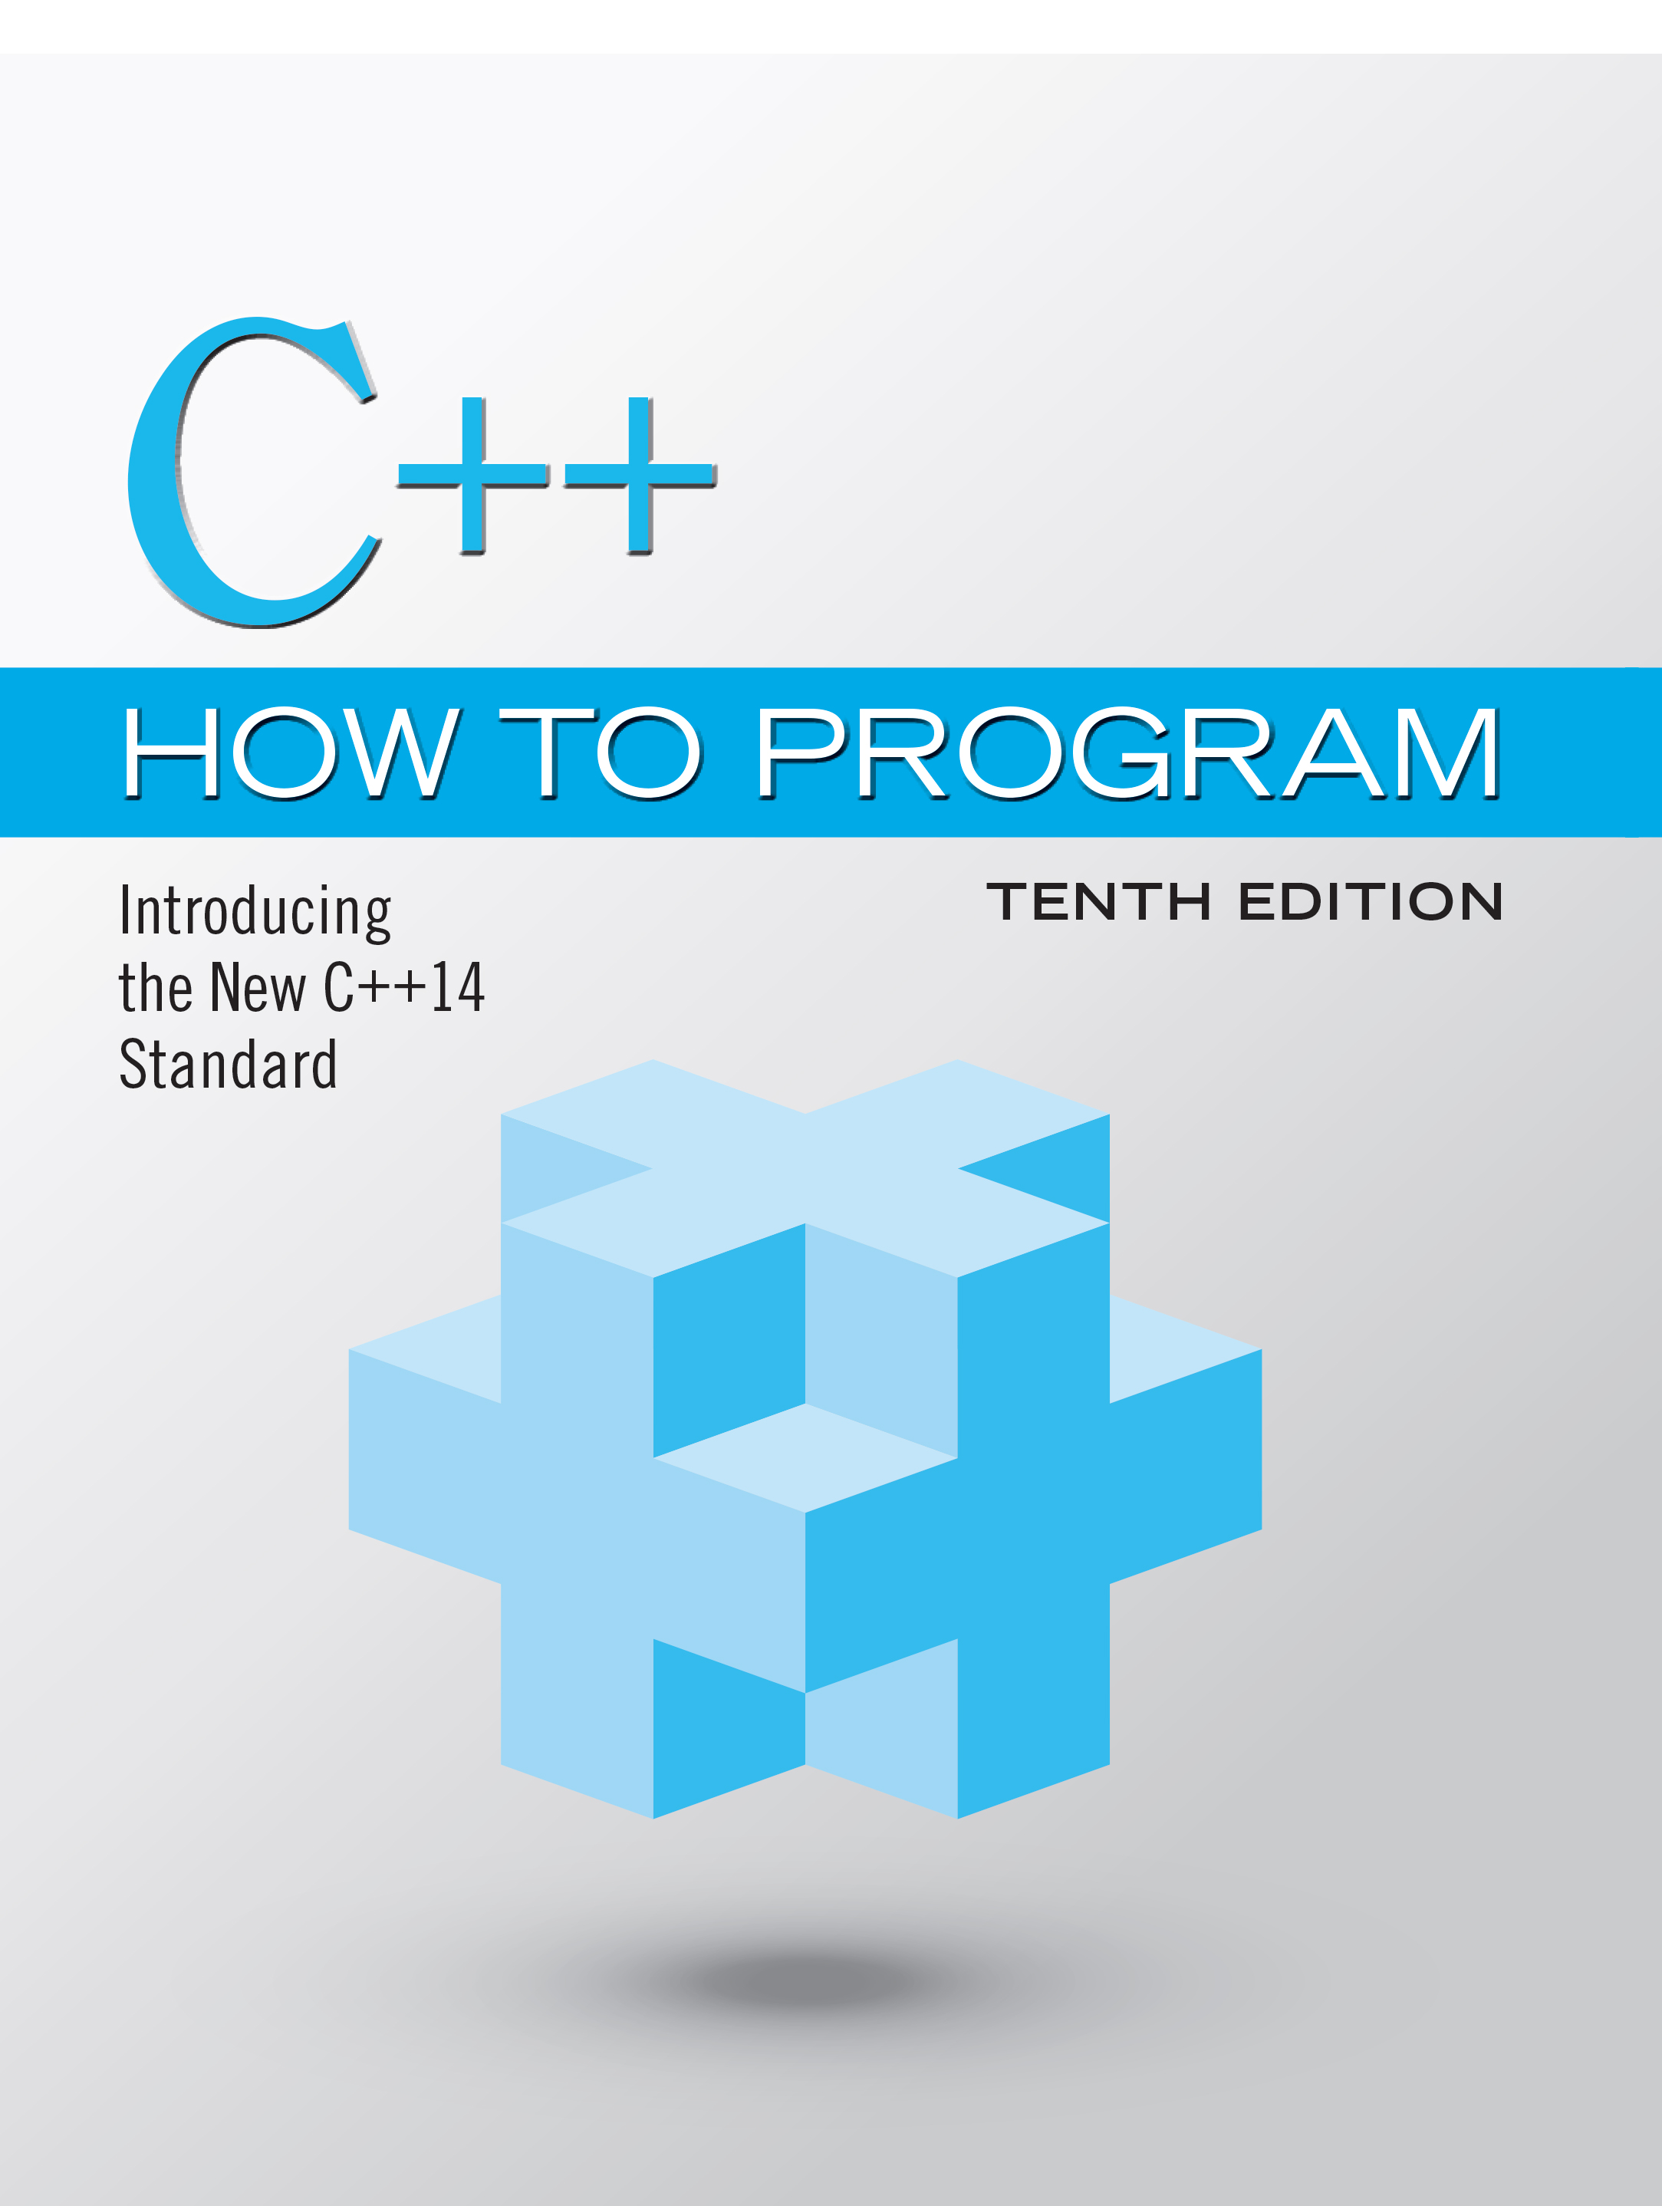
C++ How to Program: Introducing the New C++14 Standard
Tenth Edition
Chapter 10
Operator Overloading; Class string
Copyright © 2017, 2014, 2012 Pearson Education, Inc. All Rights Reserved
Notes:
If this PowerPoint presentation contains mathematical equations, you may need to check that your computer has the following installed:
1) MathType Plugin
2) Math Player (free versions available)
3) NVDA Reader (free versions available)

Slide 2
Learning Objectives (1 of 2)
In this chapter you’ll:
Learn how operator overloading can help you craft valuable classes.
Overload unary and binary operators.
Convert objects from one class to another.
Use overloaded operators and additional features of class string.
Create PhoneNumber, Date and Array classes that provide overloaded operators.

Slide 3
Learning Objectives (2 of 2)
Perform dynamic memory allocation with new and delete.
Understand how keyword explicit prevents a constructor from being used for implicit conversions.
Experience a “light-bulb moment” when you’ll truly appreciate the elegance and beauty of the class concept.

Slide 4
Outline (1 of 3)
10.1 Introduction
10.2 Using the Overloaded Operators of Standard Library Class string
10.3 Fundamentals of Operator Overloading
10.3.1 Operator Overloading Is Not Automatic
10.3.2 Operators That You Do Not Have to Overload
10.3.3 Operators That Cannot Be Overloaded
10.3.4 Rules and Restrictions on Operator Overloading

Slide 5
Outline (2 of 3)
10.4 Overloading Binary Operators
10.5 Overloading the Binary Stream Insertion and Stream Extraction Operators
10.6 Overloading Unary Operators
10.7 Overloading the Increment and Decrement Operators
10.8 Case Study: A Date Class
10.9 Dynamic Memory Management

Slide 6
Outline (3 of 3)
10.10 Case Study: Array Class
10.10.1 Using the Array Class
10.10.2 Array Class Definition
10.11 Operators as Member vs. Non-Member Functions
10.12 Converting Between Types
10.13 explicit Constructors and Conversion Operators
10.14 Overloading the Function Call Operator ()
10.15 Wrap-Up

Slide 7
10.1 Introduction
This chapter shows how to enable C++’s operators to work with class objects—a process called operator overloading.
One example of an overloaded operator built into C++ is <<, which is used both as the stream insertion operator and as the bitwise left-shift operator (which is discussed in Chapter 22).
Similarly, >> also is overloaded; it’s used both as
the stream extraction operator—defined via operator overloading in the C++ Standard Library—and
the bitwise right-shift operator—defined as part of the C++ language.

Slide 8
10.2 Using the Overloaded Operators of Standard Library Class string (1 of 6)
Figure 10.1 demonstrates many of class string’s overloaded operators and several other useful member functions, including empty, substr and at.
Function empty determines whether a string is empty, function substr (for “substring”) returns a string that’s a portion of an existing string and function at returns the character at a specific index in a string (after checking that the index is in range).
Chapter 21 presents class string in detail.

Slide 9
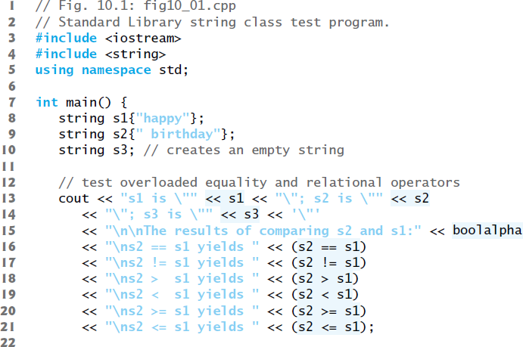
Figure 10.1 Standard Library String Class Test Program (1 of 6)

Slide 10
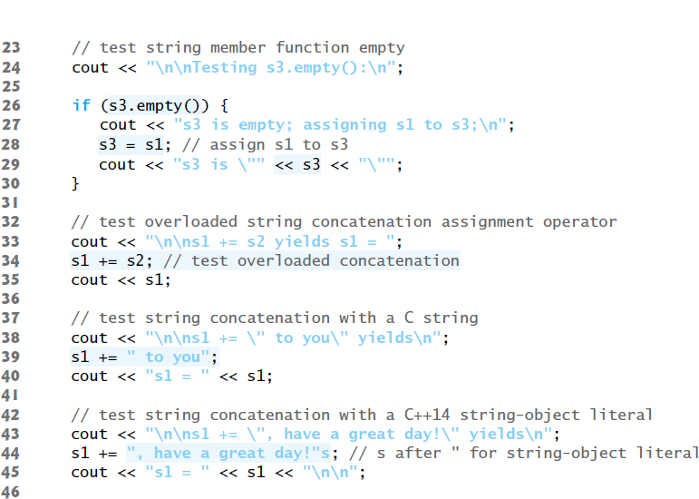
Figure 10.1 Standard Library String Class Test Program (2 of 6)

Slide 11
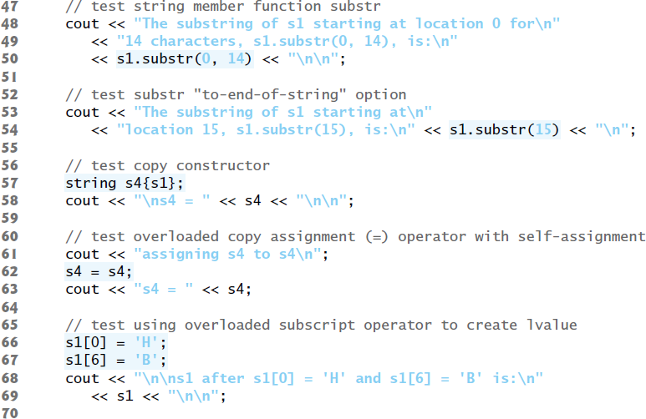
Figure 10.1 Standard Library String Class Test Program (3 of 6)

Slide 12
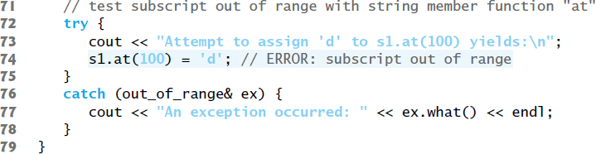
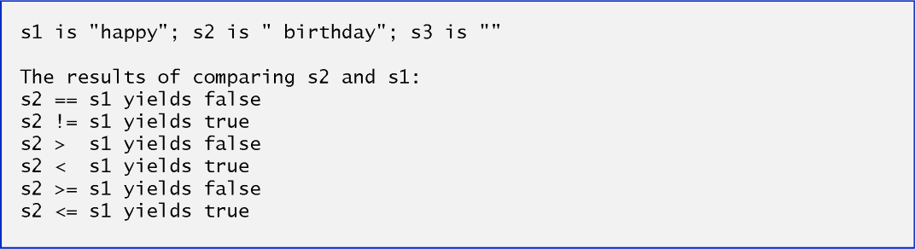
Figure 10.1 Standard Library String Class Test Program (4 of 6)

Slide 13
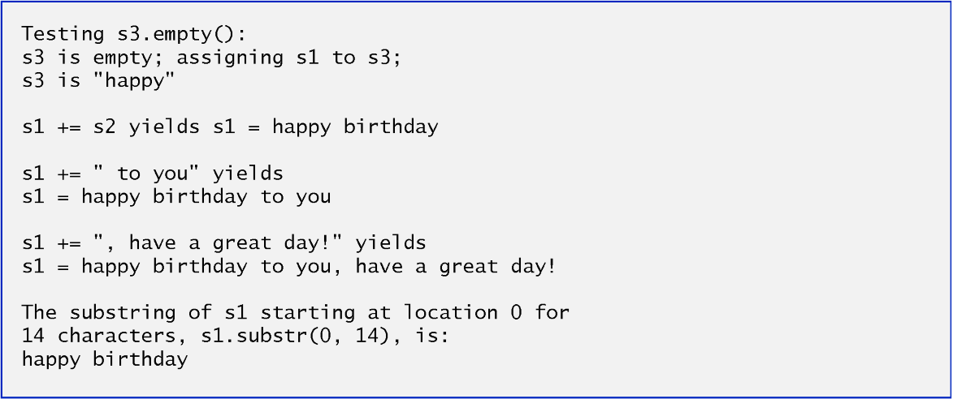
Figure 10.1 Standard Library String Class Test Program (5 of 6)

Slide 14
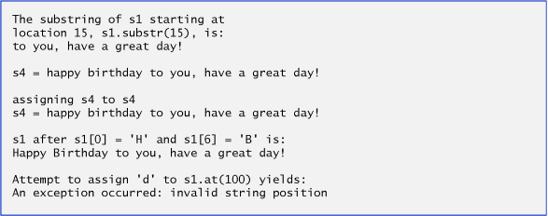
Figure 10.1 Standard Library String Class Test Program (6 of 6)

Slide 15
10.2 Using the Overloaded Operators of Standard Library Class string (2 of 6)
Class string’s overloaded equality and relational operators perform lexicographical comparisons (i.e., like a dictionary ordering) using the numerical values of the characters (see Appendix B, A S C I I Character Set) in each string.
Class string provides member function empty to determine whether a string is empty
Returns true if the string is empty; otherwise, it returns false.
Class string’s overloaded += operator performs string concatenation.
A string literal can be appended to a string object by using operator +=

Slide 16
10.2 Using the Overloaded Operators of Standard Library Class string (3 of 6)
Class string provides member function substr to return a portion of a string as a string object.
The call to substr in line 50 obtains a 14-character substring (specified by the second argument) of s1 starting at position 0 (specified by the first argument).
The call to substr in line 54 obtains a substring starting from position 15 of s1.
When the second argument is not specified, substr returns the remainder of the string on which it’s called.
Class string’s overloaded [] operator can create lvalues that enable new characters to replace existing characters in s1.
Class string’s overloaded [] operator does not perform any bounds checking.

Slide 17
10.2 Using the Overloaded Operators of Standard Library Class string (4 of 6)
Class string does provide bounds checking in its member function at, which throws an exception if its argument is an invalid subscript.
If the subscript is valid, function at returns the character at the specified location as a modifiable lvalue or a nonmodifiable lvalue (e.g., a const reference), depending on the context in which the call appears.

Slide 18
10.3 Fundamentals of Operator Overloading
Overloaded operators provide a concise notation for manipulating string objects.
You can use operators with your own user-defined types as well.
Although C++ does not allow new operators to be created, it does allow most existing operators to be overloaded so that, when they’re used with objects, they have meaning appropriate to those objects.

Slide 19
10.3.1 Operator Overloading Is Not Automatic
Operator overloading is not automatic—you must write operator-overloading functions to perform the desired operations.
An operator is overloaded by writing a non-static member function definition or non-member function definition as you normally would, except that the function name starts with the keyword operator followed by the symbol for the operator being overloaded.
For example, the function name operator+ would be used to overload the addition operator (+) for use with objects of a particular class (or enum).
When operators are overloaded as member functions, they must be non-static, because they must be called on an object of the class and operate on that object.

Slide 20
10.3.2 Operators That You Do Not Have to Overload
To use an operator on class objects, you must define overloaded operator functions for that class—with three exceptions.
The assignment operator (=) may be used with most classes to perform memberwise assignment of the data members—each data member is assigned from the assignment’s “source” object (on the right) to the “target” object (on the left).
Memberwise assignment is dangerous for classes with pointer members, so we’ll explicitly overload the assignment operator for such classes.
The address operator (&) returns a pointer to the object; this operator also can be overloaded.
The comma operator evaluates the expression to its left then the expression to its right, and returns the value of the latter expression.

Slide 21
10.3.3 Operators That Cannot Be Overloaded
Most of C++’s operators can be overloaded.
Figure 10.2 shows the operators that cannot be overloaded.

Slide 22

Figure 10.2 Operators That Cannot Be Overloaded

Slide 23
10.3.4 Rules and Restrictions on Operator Overloading (1 of 3)
An operator’s precedence cannot be changed by overloading.
However, parentheses can be used to force the order of evaluation of overloaded operators in an expression.
An operator’s associativity cannot be changed by overloading
if an operator normally associates from left to right, then so do all of its overloaded versions.
An operator’s “arity” (that is, the number of operands an operator takes) cannot be change
overloaded unary operators remain unary operators; overloaded binary operators remain binary operators. Operators &, *, + and - all have both unary and binary versions; these unary and binary versions can be separately overloaded.

Slide 24
10.3.4 Rules and Restrictions on Operator Overloading (2 of 3)
Only existing operators can be overloaded.
You cannot overload operators how an operator works for fundamental type values
For example, you cannot make the + operator subtract two ints. Operator overloading works only with objects of user-defined types or with a mixture of an object of a user-defined type and an object of a fundamental type.

Slide 25
10.3.4 Rules and Restrictions on Operator Overloading (3 of 3)
Related operators, like + and +=, must be overloaded separately.
When overloading (), [], -> or any of the assignment operators, the operator overloading function must be declared as a class member.
For all other overloadable operators, the operator overloading functions can be member functions or non-member functions.

Slide 26
Software Engineering Observation 10.1
Overload operators for class types so they work as closely as possible to the way built-in operators work on fundamental types.

Slide 27
10.4 Overloading Binary Operators
A binary operator can be overloaded as a non-static member function with one parameter or as a non-member function with two parameters (one of those parameters must be either a class object or a reference to a class object).
As a non-member function, binary operator < must take two arguments—one of which must be an object (or a reference to an object) of the class.

Slide 28
10.5 Overloading the Binary Stream Insertion and Stream Extraction Operators (1 of 6)
You can input and output fundamental-type data using the stream extraction operator >> and the stream insertion operator <<.
The C++ class libraries overload these binary operators for each fundamental type, including pointers and char * strings.
You can also overload these operators to perform input and output for your own types.
The program of Figs. 10.3–10.5 overloads these operators to input and output PhoneNumber objects in the format “(000) 000-0000.”

Slide 29
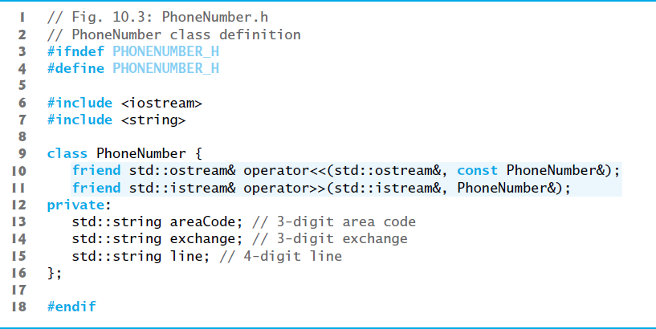
Figure 10.3 PhoneNumber Class with Overloaded Stream Insertion and Stream Extraction Operators as Friend Functions

Slide 30
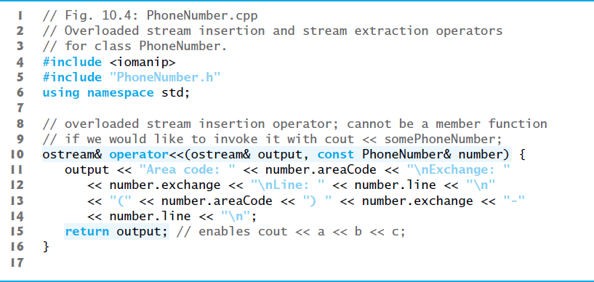
Figure 10.4 | Overloaded Stream Insertion and Stream Extraction Operators for Class PhoneNumber (1 of 2)

Slide 31
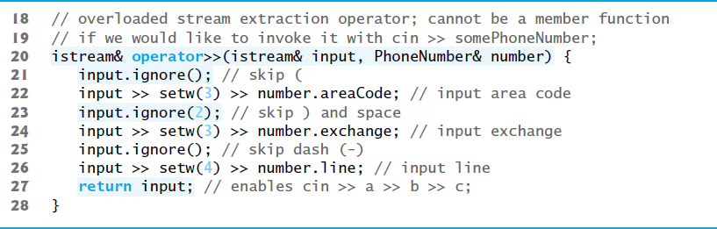
Figure 10.4 | Overloaded Stream Insertion and Stream Extraction Operators for Class PhoneNumber (2 of 2)

Slide 32
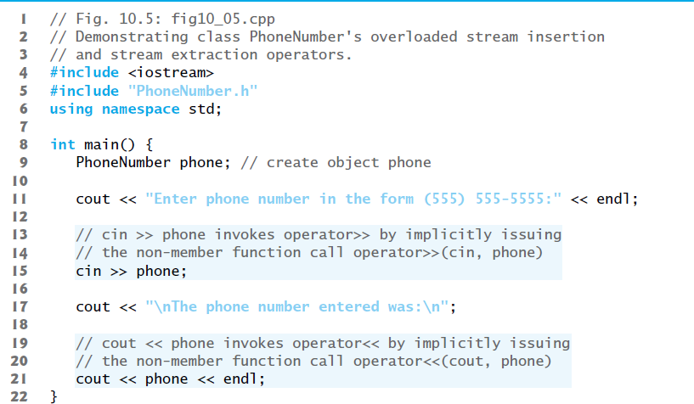
Figure 10.5 Overloaded Stream Insertion and Stream Extraction Operators (1 of 3)

Slide 33

Figure 10.5 Overloaded Stream Insertion and Stream Extraction Operators (2 of 3)

Slide 34
10.5 Overloading the Binary Stream Insertion and Stream Extraction Operators (2 of 6)
Overloading the Stream Extraction (>>) Operator
The stream extraction operator function operator>> takes istream reference input and PhoneNumber reference number as arguments and returns an istream reference.
Function operator>> inputs phone numbers of the form
(800) 555-1212
When the compiler sees the expression
cin >> phone
It generates the non-member function call
operator>>( cin, phone );
When this executes, reference parameter input becomes an alias for cin and reference parameter number becomes an alias for phone.

Slide 35
10.5 Overloading the Binary Stream Insertion and Stream Extraction Operators (3 of 6)
Stream manipulator setw limits the number of characters read into each string.
The parentheses, space and dash characters are skipped by calling istream member function ignore, which discards the specified number of characters in the input stream (one character by default).

Slide 36
10.5 Overloading the Binary Stream Insertion and Stream Extraction Operators (4 of 6)
Function operator>> returns istream reference input (i.e., cin).
Enables input operations on PhoneNumber objects to be cascaded with input operations on other PhoneNumber objects or on objects of other data types.

Slide 37
Good Programming Practice 10.1
Overloaded operators should mimic the functionality of their built-in counterparts—e.g., the + operator should perform addition, not subtraction. Avoid excessive or inconsistent use of operator overloading, as this can make a program cryptic and difficult to read.

Slide 38
10.5 Overloading Stream Insertion and Stream Extraction Operators (3 of 3)
Overloading the Stream Insertion (<<) Operator
The stream insertion operator function takes an ostream reference (output) and a const PhoneNumber reference (number) as arguments and returns an ostream reference.
Function operator<< displays objects of type PhoneNumber.
When the compiler sees the expression
cout << phone
it generates the non-member function call
operator<<( cout, phone );
Function operator<< displays the parts of the telephone number as strings, because they’re stored as string objects.

Slide 39
10.5 Overloading the Binary Stream Insertion and Stream Extraction Operators (5 of 6)
Overloaded Operators as Non-Member friend Functions
The functions operator>> and operator<< are declared in PhoneNumber as non-member, friend functions.
They’re non-member functions because the object of class PhoneNumber is the operator’s right operand.

Slide 40
Software Engineering Observation 10.2
New input/output capabilities for user-defined types are added to C++ without modifying standard input/output library classes. This is another example of C++’s extensibility.

Slide 41
10.5 Overloading the Binary Stream Insertion and Stream Extraction Operators (6 of 6)
The overloaded stream insertion operator (<<) is used in an expression in which the left operand has type ostream &, as in cout << classObject.
When the right operand is an object of a user-defined class, it must be overloaded as a non-member function.
Similarly, the overloaded stream extraction operator (>>) must be a non-member function.
Each may require access to the private data members of the class object being output or input, so these overloaded operator functions can be made friend functions of the class for performance reasons.

Slide 42
10.6 Overloading Unary Operators
A unary operator for a class can be overloaded as a non-static member function with no arguments or as a non-member function with one argument that must be an object (or a reference to an object) of the class.
A unary operator such as ! may be overloaded as a non-member function with one parameter.

Slide 43
10.7 Overloading the Increment and Decrement Operators
The prefix and postfix versions of the increment and decrement operators can all be overloaded.
To overload the increment operator to allow both prefix and postfix increment usage, each overloaded operator function must have a distinct signature, so that the compiler will be able to determine which version of ++ is intended.
The prefix versions are overloaded exactly as any other prefix unary operator would be.

Slide 44
10.7 Overloading the Unary Prefix and Postfix ++ and -- Operators (1 of 4)
When the compiler sees the preincrementing expression ++d1, if the overloaded operator is defined as a member function, the compiler generates the member-function call
d1.operator++()
The prototype for this operator function would be
Date &operator++();
If the prefix increment operator is implemented as a non-member function, then the compiler generates the function call
operator++( d1 )
The prototype for this operator function would be declared in the Date class as
Date &operator++( Date & );

Slide 45
10.7 Overloading the Unary Prefix and Postfix ++ and -- Operators (2 of 4)
Overloading the Postfix Increment Operator
Overloading the postfix increment operator presents a challenge, because the compiler must be able to distinguish between the signatures of the overloaded prefix and postfix increment operator functions.
The convention that has been adopted in C++ is that, when the compiler sees the postincrementiang expression d1++, it generates the member-function call
d1.operator++(0)
The prototype for this function is
Date operator++(int)

Slide 46
10.7 Overloading the Unary Prefix and Postfix ++ and -- Operators (3 of 4)
The argument 0 is strictly a “dummy value” that enables the compiler to distinguish between the prefix and postfix increment operator functions.
The same syntax is used to differentiate between the prefix and postfix decrement operator functions.

Slide 47
10.7 Overloading the Unary Prefix and Postfix ++ and -- Operators (4 of 4)
If the postfix increment is implemented as a non-member function, then, when the compiler sees the expression d1++, the compiler generates the function call
operator++(d1, 0)
The prototype for this function would be
Date operator++(Date &, int);
The 0 argument is used by the compiler to distinguish between the prefix and postfix increment operator non-member functions.
The postfix increment operator returns Date objects by value, whereas the prefix increment operator returns Date objects by reference—the postfix increment operator typically returns a temporary object that contains the original value of the object before the increment occurred.

Slide 48
Performance Tip 10.1
The extra object that’s created by the postfix increment (or decrement) operator can result in a performance problem—especially when the operator is used in a loop. For this reason, you should prefer the overloaded prefix increment and decrement operators.

Slide 49
10.8 Case Study: A Date Class
The program of Figs. 10.6–10.8 demonstrates a Date class, which uses overloaded prefix and postfix increment operators to add 1 to the day in a Date object, while causing appropriate increments to the month and year if necessary.

Slide 50
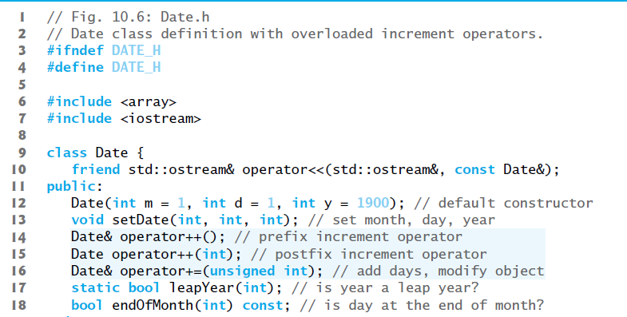
Figure 10.6 Date Class Definition with Overloaded Increment Operators (1 of 2)

Slide 51
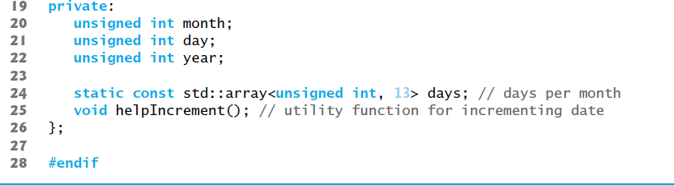
Figure 10.6 Date Class Definition with Overloaded Increment Operators (2 of 2)

Slide 52
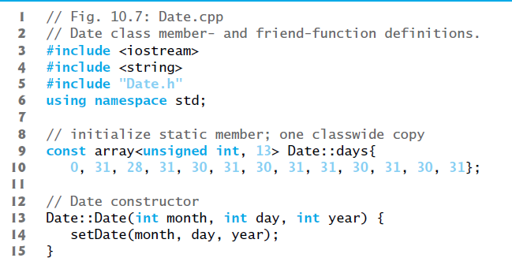
Figure 10.7 Date Class Member- and Friend-Function Definitions (1 of 7)

Slide 53
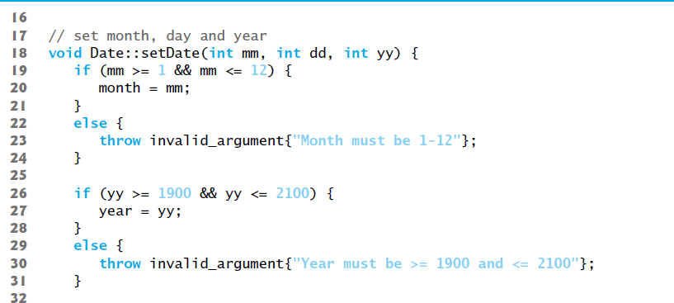
Figure 10.7 Date Class Member- and Friend-Function Definitions (2 of 7)

Slide 54
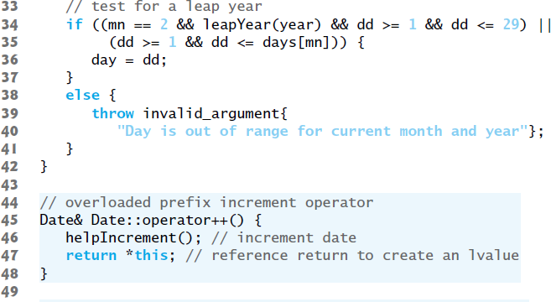
Figure 10.7 Date Class Member- and Friend-Function Definitions (3 of 7)

Slide 55
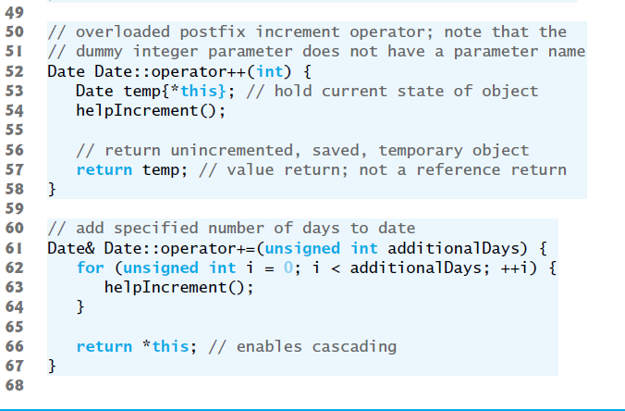
Figure 10.7 Date Class Member- and Friend-Function Definitions (4 of 7)

Slide 56
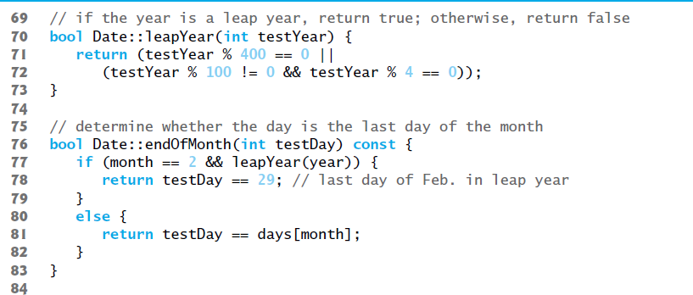
Figure 10.7 Date Class Member- and Friend-Function Definitions (5 of 7)

Slide 57
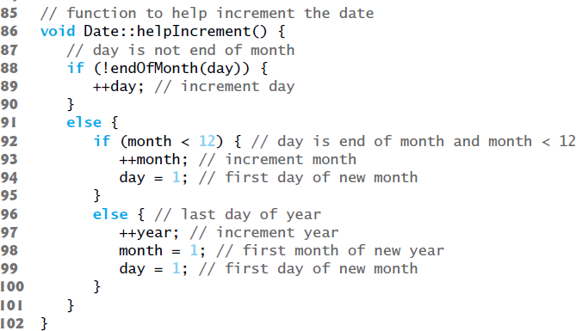
Figure 10.7 Date Class Member- and Friend-Function Definitions (6 of 7)

Slide 58
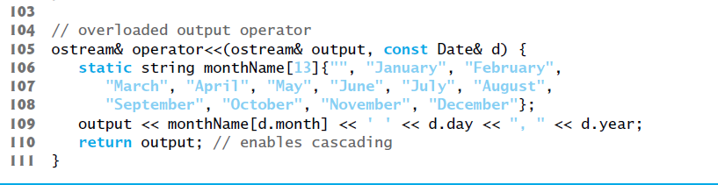
Figure 10.7 Date Class Member- and Friend-Function Definitions (7 of 7)

Slide 59
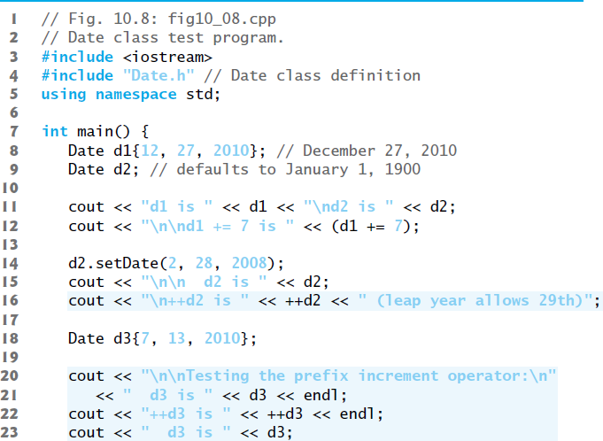
Figure 10.8 Date Class Test Program (1 of 2)

Slide 60
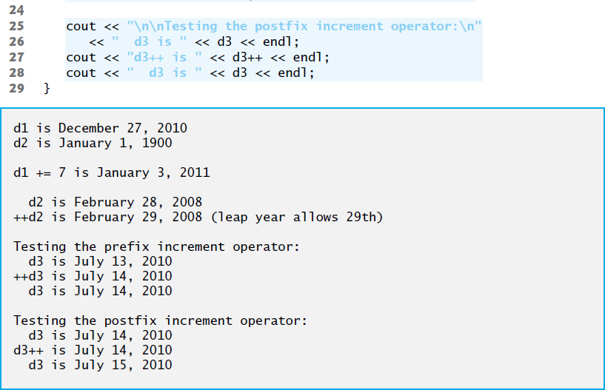
Figure 10.8 Date Class Test Program (2 of 2)

Slide 61
10.8 Case Study: A Date Class ( 1 of 4)
The Date constructor calls setDate to validate the month, day and year specified.
Invalid values for the month, day or year result in invalid_argument exceptions.

Slide 62
10.8 Case Study: A Date Class ( 2 of 4)
Date Class Prefix Increment Operator
Overloading the prefix increment operator is straightforward.
The prefix increment operator calls utility function helpIncrement to increment the date.
This function deals with “wraparounds” or “carries” that occur when we increment the last day of the month.
These carries require incrementing the month.
If the month is already 12, then the year must also be incremented and the month must be set to 1.
Function helpIncrement uses function endOfMonth to determine whether the end of a month has been reached and increment the day correctly.

Slide 63
10.8 Case Study: A Date Class ( 3 of 4)
The overloaded prefix increment operator returns a reference to the current Date object (i.e., the one that was just incremented).
This occurs because the current object, *this, is returned as a Date &.
Enables a preincremented Date object to be used as an lvalue, which is how the built-in prefix increment operator works for fundamental types.

Slide 64
10.8 Case Study: A Date Class ( 4 of 4)
Date Class Postfix Increment Operator
Overloading the postfix increment operator is trickier.
To emulate the effect of the postincrement, we must return an unincremented copy of the Date object—we’d like our postfix increment operator to operate the same way on a Date object.
On entry to operator++, we save the current object (*this) in temp.
Next, we call helpIncrement to increment the current Date object then return the unincremented copy of the object previously stored in temp.
This function cannot return a reference to the local Date object temp, because a local variable is destroyed when the function in which it’s declared exits.

Slide 65
10.9 Dynamic Memory Management (1 of 7)
You can control memory allocation and deallocation in a program for objects and for arrays of any built-in or user-defined type.
Known as dynamic memory management; performed with new and delete.
Use the new operator to dynamically allocate (i.e., reserve) the exact amount of memory required to hold an object or built-in array at execution time.
The object or built-in array is created in the free store (also called the heap)—a region of memory assigned to each program for storing dynamically allocated objects.
Once memory is allocated, you can access it via the pointer that operator new returns.
Return memory by using the delete operator to deallocate it.

Slide 66
10.9 Dynamic Memory Management (2 of 7)
Obtaining Dynamic Memory with new
The new operator allocates storage of the proper size for an object of type Time, calls the default constructor to initialize the object and returns a pointer to the type specified to the right of the new operator (i.e., a Time *).
If new is unable to find sufficient space in memory for the object, it indicates that an error occurred by “throwing an exception.”

Slide 67
10.9 Dynamic Memory Management (3 of 7)
Releasing Dynamic Memory with delete
To destroy a dynamically allocated object, use the delete operator as follows:
delete ptr;
This statement first calls the destructor for the object to which ptr points, then deallocates the memory associated with the object, returning the memory to the free store.

Slide 68
Common Programming Error 10.1
Not releasing dynamically allocated memory when it’s no longer needed can cause the system to run out of memory prematurely. This is sometimes called a “memory leak.”

Slide 69
Error-Prevention Tip 10.1
Do not delete memory that was not allocated by new. Doing so results in undefined behavior.

Slide 70
Error-Prevention Tip 10.2
After you delete a block of dynamically allocated memory, be sure not to delete the samenblock again. One way to guard against this is to immediately set the pointer to nullptr. Deleting a nullptr has no effect.

Slide 71
10.9 Dynamic Memory Management (4 of 7)
Initializing Dynamic Memory
You can provide an initializer for a newly created fundamental-type variable, as in
double *ptr{new double{3.14159}};
The same syntax can be used to specify a comma-separated list of arguments to the constructor of an object.

Slide 72
10.9 Dynamic Memory Management (5 of 7)
Dynamically Allocating Built-In Arrays with new []
You can also use the new operator to allocate built-in arrays dynamically.
For example, a 10-element integer array can be allocated and assigned to gradesArray as follows:
int *gradesArray{new int[10]{}};
The {} following new int[10] value initialize the array’s elements—fundamental numeric types are set to 0, bools are set to false, pointers are set to nullptr and class objects are initialized by their default constructors.
A dynamically allocated array’s size can be specified using any non-negative integral expression that can be evaluated at execution time.

Slide 73
10.9 Dynamic Memory Management (6 of 7)
Releasing Dynamically Allocated Built-In Arrays with delete []
To deallocate a dynamically allocated array, use the statement
delete [] ptr;
If the pointer points to a built-in array of objects, the statement first calls the destructor for every object in the array, then deallocates the memory.
Using delete or [] on a nullptr has no effect.

Slide 74
Common Programming Error 10.2
Using delete instead of delete[] for built-in arrays of objects can lead to runtime logic errors. To ensure that every object in the array receives a destructor call, always delete memory allocated as an array with operator delete[]. Similarly, always delete memory allocated as an individual element with operator delete—the result of deleting a single object with operator delete[] is undefined.

Slide 75
10.9 Dynamic Memory Management (7 of 7)
C++11: Managing Dynamically Allocated Memory with unique_ptr
C++11’s new unique_ptr is a “smart pointer” for managing dynamically allocated memory.
When a unique_ptr goes out of scope, its destructor automatically returns the managed memory to the free store.

Slide 76
10.10 Case Study: Array Class (1 of 2)
Pointer-based arrays have many problems, including:
A program can easily “walk off” either end of a built-in array, because C++ does not check whether subscripts fall outside the range of the array.
Built-in arrays of size n must number their elements 0, …, n – 1; alternate subscript ranges- are not allowed.
An entire built-in array cannot be input or output at once.
Two built-in arrays cannot be meaningfully compared with equality or relational operators.
When an array is passed to a general-purpose function designed to handle arrays of any size, the array’s size must be passed as an additional argument.
One built-in array cannot be assigned to another with the assignment operator.

Slide 77
10.10 Case Study: Array Class (2 of 2)
With C++, you can implement more robust array capabilities via classes and operator overloading as has been done with class templates array and vector in the C++ Standard Library.
In this section, we’ll develop our own custom array class that’s preferable to built-in arrays.
In this example, we create a powerful Array class:
Performs range checking.
Allows one Array object to be assigned to another with the assignment operator.

Slide 78
10.10 Case Study: Array Class (3 of 3)
Objects know their own size.
Input or output entire arrays with the stream extraction and stream insertion operators, respectively.
Can compare Arrays with the equality operators == and !=.
C++ Standard Library class template vector provides many of these capabilities as well.

Slide 79
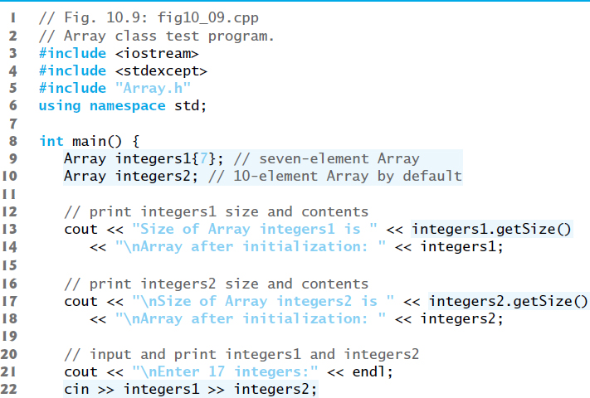
Figure 10.9 Array Class Test Program (1 of 5)

Slide 80
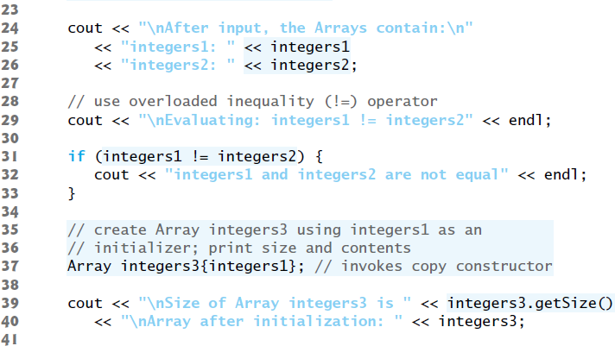
Figure 10.9 Array Class Test Program (2 of 5)

Slide 81
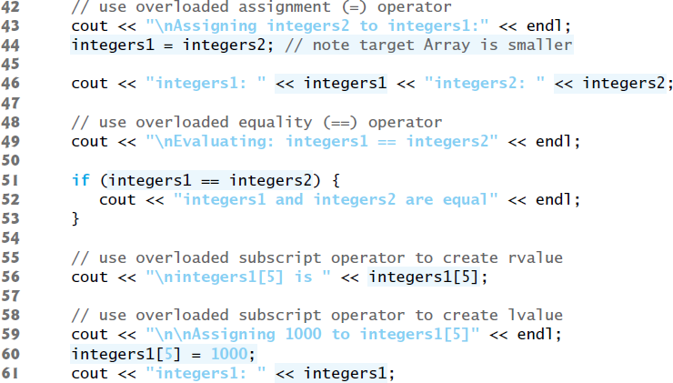
Figure 10.9 Array Class Test Program (3 of 5)

Slide 82
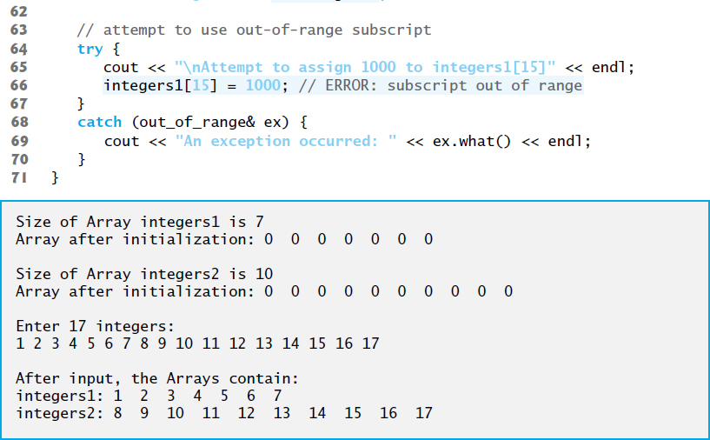
Figure 10.9 Array Class Test Program (4 of 5)

Slide 83
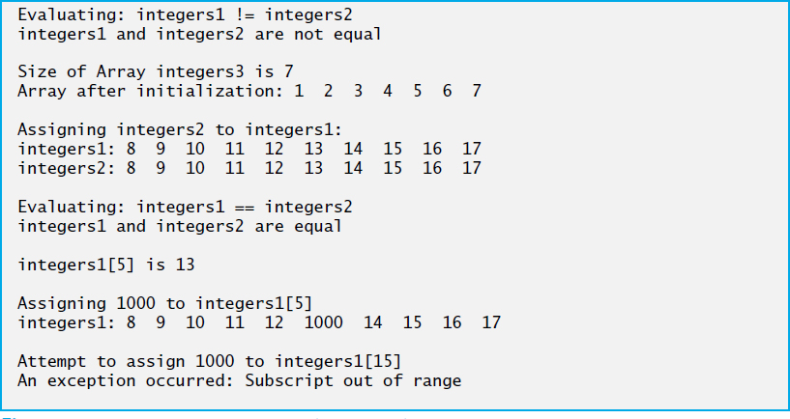
Figure 10.9 Array Class Test Program (5 of 5)

Slide 84
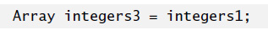
10.10.1 Using the Array Class (1 of 3)
The Array copy constructor copies the elements of one Array into another.
The copy constructor can also be invoked by writing line 37 as:
The equal sign in the preceding statement is not the assignment operator.
When an equal sign appears in the declaration of an object, it invokes a constructor for that object.
This form can be used to pass only a single argument to a constructor.

Slide 85
10.10.1 Using the Array Class (2 of 3)
The array subscript operator [] is not restricted for use only with arrays; it also can be used, for example, to select elements from other kinds of container classes, such as strings and dictionaries.
Also, when operator[] functions are defined, subscripts no longer have to be integers—characters, strings, floats or even objects of user-defined classes also could be used.

Slide 86


10.10.1 Using the Array Class (3 of 3)
Each Array object consists of a size member indicating the number of elements in the Array and an int pointer—ptr—that points to the dynamically allocated pointer-based array of integers managed by the Array object.
When the compiler sees an expression like cout << arrayObject, it invokes non-member function operator<< with the call
When the compiler sees an expression like cin >> arrayObject, it invokes non-member function operator>> with the call
These stream insertion and stream extraction operator functions cannot be members of class Array, because the Array object is always mentioned on the right side of the stream insertion operator and the stream extraction operator.

Slide 87
10.10.2 Array Class Definition (1 of 15)
You might be tempted to replace the counter-controlled for statements in class Array’s implementation with the C++11 range-based for statement.
Unfortunately, range-based for does not work with dynamically allocated built-in arrays.

Slide 88
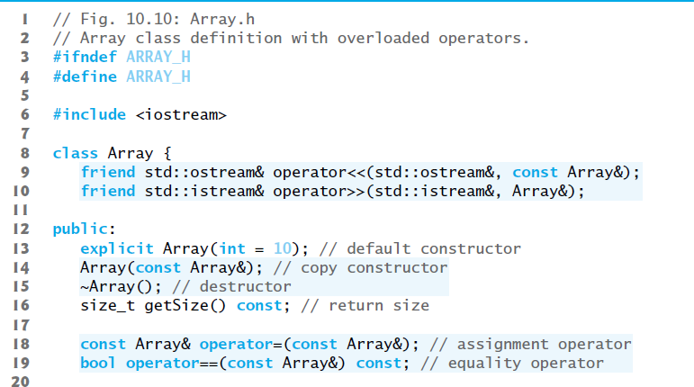
Figure 10.10 Array Class Definition with Overloaded Operators (1 of 2)

Slide 89
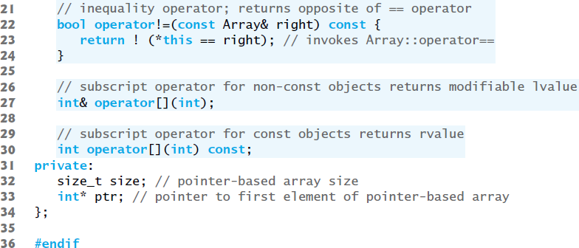
Figure 10.10 Array Class Definition with Overloaded Operators (2 of 2)

Slide 90
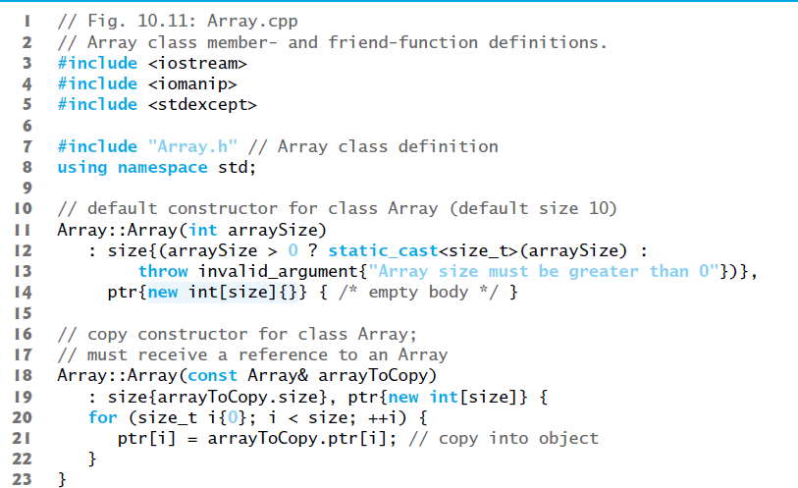
Figure 10.11 Array Class Member- and Friend-Function Definitions (1 of 6)

Slide 91
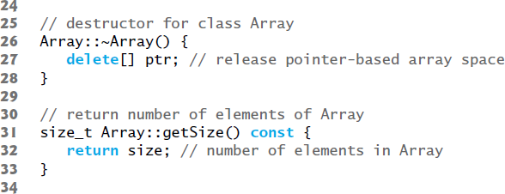
Figure 10.11 Array Class Member- and Friend-Function Definitions (2 of 6)

Slide 92
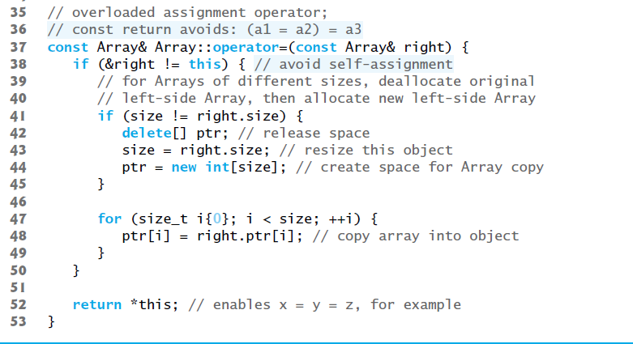
Figure 10.11 Array Class Member- and Friend-Function Definitions (3 of 6)

Slide 93
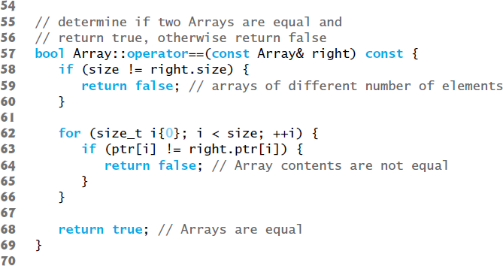
Figure 10.11 Array Class Member- and Friend-Function Definitions (4 of 6)

Slide 94
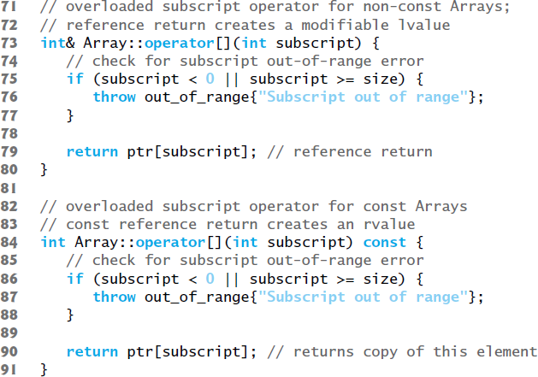
Figure 10.11 Array Class Member- and Friend-Function Definitions (5 of 6)

Slide 95
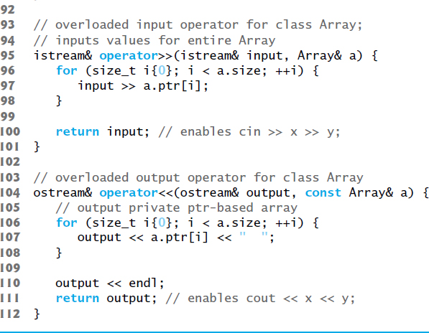
Figure 10.11 Array Class Member- and Friend-Function Definitions (6 of 6)

Slide 96
10.10.2 Array Class Definition (2 of 15)
Array Default Constructor
Line 13 of Figure 10.10 declares the default constructor for the class and specifies a default size of 10 elements.
The default constructor (defined in Figure 10.11, lines 14) validates and assigns the argument to data member size, uses new to obtain the memory for the internal pointer-based representation of this Array and assigns the pointer returned by new to data member ptr.
Then the constructor uses a for statement to set all the elements of the array to zero.

Slide 97
10.10.2 Array Class Definition (3 of 15)
Array Copy Constructor
Line 14 of Figure 10.10 declares a copy constructor (defined in Figure 10.11, lines 18–23) that initializes an Array by making a copy of an existing Array object.
Such copying must be done carefully to avoid the pitfall of leaving both Array objects pointing to the same dynamically allocated memory.
This is exactly the problem that would occur with default memberwise copying, if the compiler is allowed to define a default copy constructor for this class.
Copy constructors are invoked whenever a copy of an object is needed, such as in passing an object by value to a function, returning an object by value from a function or initializing an object with a copy of another object of the same class.

Slide 98
10.10.2 Array Class Definition (4 of 15)
The copy constructor for Array copies the size of the initializer Array into data member size, uses new to obtain the memory for the internal pointer-based representation of this Array and assigns the pointer returned by new to data member ptr.
Then the copy constructor uses a for statement to copy all the elements of the initializer Array into the new Array object.
An object of a class can look at the private data of any other object of that class (using a handle that indicates which object to access).

Slide 99
Software Engineering Observation 10.3
The argument to a copy constructor should be a const reference to allow a const object to be copied.

Slide 100
Common Programming Error 10.3
If the copy constructor simply copied the pointer in the source object to the target object’s pointer, then both would point to the same dynamically allocated memory. The first destructor to execute would delete the dynamically allocated memory, and the other object’s ptr would point to memory that’s no longer allocated, a situation called a dangling pointer—this would likely result in a serious runtime error (such as early program termination) when the pointer was used.

Slide 101
10.10.2 Array Class Definition (5 of 15)
Array Destructor
Line 15 of Figure 10.10 declares the class’s destructor (defined in Figure 10.11, lines 26–28).
The destructor is invoked when an object of class Array goes out of scope.
The destructor uses delete [] to release the memory allocated dynamically by new in the constructor.

Slide 102
Error-Prevention Tip 10.3
If after deleting dynamically allocated memory, the pointer will continue to exist in memory, set the pointer’s value to nullptr to indicate that the pointer no longer points to memory in the free store. When the pointer is set to nullptr, the program loses access to that free-store space, which could be reallocated for a different purpose. If you do not set the pointer to nullptr, your code could inadvertently access the reallocated memory, causing subtle, nonrepeatable logic errors. We did not set ptr to nullptr in the destructor, because after the destructor executes, the Array object no longer exists in memory.

Slide 103
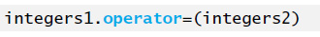
10.10.2 Array Class Definition (6 of 15)
Overloaded Assignment Operator
Line 18 of Figure 10.10 declares the overloaded assignment operator function for the class.
When the compiler sees the expression integers1=integers2 in line 44of Figure 10.9, the compiler invokes member function operator= with the call
Member function operator=’s implementation (Figure 10.11, lines 37–53) tests for self-assignment in which an Array object is being assigned to itself.
When this is equal to the right operand’s address, a self-assignment is being attempted, so the assignment is skipped.

Slide 104
10.10.2 Array Class Definition (7 of 15)
operator= determines whether the sizes of the two Arrays are identical (line 41); in that case, the original array of integers in the left-side Array object is not reallocated.
Otherwise, operator= uses delete [] (line 42) to release the memory, copies the size of the source array to the size of the target Array (line 43), uses new to allocate memory for the target Array and places the pointer returned by new into the Array’s ptr member.
Regardless of whether this is a self-assignment, thse member function returns the current object (i.e., *this in line 52) as a constant reference; this enables cascaded Array assignments such as x = y = z, but prevents ones like (x = y) = z because z cannot be assigned to the const Array reference that is returned by (x = y).

Slide 105
Software Engineering Observation 10.4
A copy constructor, a destructor and an overloaded assignment operator are usually provided as a group for any class that uses dynamically allocated memory. With the addition of move semantics in C++11, other functions should also be provided, as you’ll see in Chapter 24.

Slide 106
Common Programming Error 10.4
Not providing a copy constructor and overloaded assignment operator for a class when objects of that class contain pointers to dynamically allocated memory is a potential logic error.

Slide 107
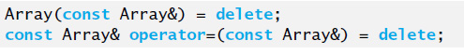
10.10.2 Array Class Definition (8 of 15)
C++11: Deleting Unwanted Member Functions from Your Class
Prior to C++11, you could prevent class objects from being copied or assigned by declaring as private the class’s copy constructor and overloaded assignment operator.
As of C++11, you can simply delete these functions from your class.
To do so in class Array, replace the prototypes in lines 14 and 18 of Figure 10.10 with:
Though you can delete any member function, it’s most commonly used with member functions that the compiler can auto-generate—the default constructor, copy constructor, assignment operator, and in C++ 11, the move constructor and move assignment operator.

Slide 108
10.10.2 Array Class Definition (9 of 15)
Overloaded Equality and Inequality Operators
Line 19 of Figure 10.10 declares the overloaded equality operator (==)
When the compiler sees the expression integers1 == integers2 in line 51 of Figure 10.9, it invokes member function operator== with the call
Member function operator== (defined in Figure 10.11, lines 57–69) immediately returns false if the size members of the Arrays are not equal.
Otherwise, operator== compares each pair of elements.
If they’re all equal, the function returns true.
The first pair of elements to differ causes the function to return false immediately.

Slide 109
10.10.2 Array Class Definition (10 of 15)
Lines 22–24 Figure 10.9 define the overloaded inequality operator (!=) for the class.
Member function operator!= uses the overloaded operator== function to deter-mine whether one Array is equal to another, then returns the opposite of that result.
Writing operator!= in this manner enables you to reuse operator==, which reduces the amount of code that must be written in the class.
Also, the full function definition for operator!= is in the Array header—Allows the compiler to inline the definition.

Slide 110
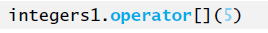
10.10.2 Array Class Definition (11 of 15)
Overloaded Subscript Operators
Lines 27 and 30 of Figure 10.10 declare two overloaded subscript operators
When the compiler sees the expression integers1[5] (Figure 10.9, line 56), it invokes the appropriate overloaded operator[]member function by generating the call
The compiler creates a call to the const version of operator[] (Figure 10.11, lines 84–91) when the subscript operator is used on a const Array object.

Slide 111
10.10.2 Array Class Definition (12 of 15)
Each definition of operator[] determines whether the subscript it receives as an argument is in range.
If it isn’t, each function prints an error message and terminates the program with a call to function exit.
If the subscript is in range, the non-const version of operator[] returns the appropriate Array element as a reference so that it may be used as a modifiable lvalue.
If the subscript is in range, the const version of operator[] returns a copy of the appropriate element of the Array.

Slide 112
10.10.2 Array Class Definition (13 of 15)
C++11: Managing Dynamically Allocated Memory with unique_ptr
In this case study, class Array’s destructor used delete [] to return the dynamically allocated built-in array to the free store.
As you recall, C++11 enables you to use unique_ptr to ensure that this dynamically allocated memory is deleted when the Array object goes out of scope.

Slide 113
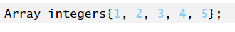
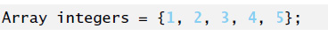
10.10.2 Array Class Definition (14 of 15)
C++11: Passing a List Initializer to a Constructor
In Figure 7.4, we showed how to initialize an array object with a comma-separated list of initializers in braces, as in
Can also use with objects of your own classes.
Can provide an Array constructor that would enabled the following declarations:
or
each of which creates an Array object with five elements containing the integers from 1 to 5.

Slide 114
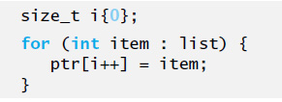
10.10.2 Array Class Definition (15 of 15)
To support list initialization, you can define a constructor that receives an object of the class template initializer_list. For class Array, you’d include the <initializer_list> header.
Then, you’d define a constructor with the first line:
You can determine the number of elements in the list parameter by calling its size member function.
To obtain each initializer and copy it into the Array object’s dynamically allocated built-in array, use a range-based for:

Slide 115
10.11 Operators as Member versus. Non-Member Functions (1 of 2)
Whether an operator function is implemented as a member function or as a non-member function, the operator is still used the same way in expressions.
When an operator function is implemented as a member function, the leftmost (or only) operand must be an object (or a reference to an object) of the operator’s class.
If the left operand must be an object of a different class or a fundamental type, this operator function must be implemented as a non-member function (as we did in Section 10.5 when overloading << and >> as the stream insertion and extraction operators, respectively).
A non-member operator function can be made a friend of a class if that function must access private or protected members of that class directly.

Slide 116
10.11 Operators as Member versus. Non-Member Functions (2 of 2)
Operator member functions of a specific class are called only when the left operand of a binary operator is specifically an object of that class, or when the single operand of a unary operator is an object of that class.
You might choose a non-member function to overload an operator to enable the operator to be commutative.
The operator+ function that deals with the HugeInt on the left, can still be a member function.
The non-member function simply swaps its arguments and calls the member function.

Slide 117
10.12 Converting between Types (1 of 5)
Sometimes all the operations “stay within a type.” For example, adding an int to an int produces an int.
It’s often necessary, however, to convert data of one type to data of another type.
The compiler knows how to perform certain conversions among fundamental types.
You can use cast operators to force conversions among fundamental types.
The compiler cannot know in advance how to convert among user-defined types, and between user-defined types and fundamental types, so you must specify how to do this.

Slide 118
10.12 Converting between Types (2 of 5)
Such conversions can be performed with conversion constructors—constructors that can be called with a single argument (we’ll refer to these as single-argument constructors).
Such constructors can turn objects of other types (including fundamental types) into objects of a particular class.

Slide 119
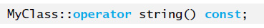
10.12 Converting between Types (3 of 5)
Conversion Operators
A conversion operator (also called a cast operator) can be used to convert an object of one class to another type.
Such a conversion operator must be a non-static member function.
Declares an overloaded cast operator function for converting an object of class MyClass into a temporary string.
The operator function is declared const because it does not modify the original object.

Slide 120
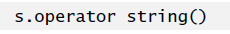
10.12 Converting between Types (4 of 5)
The return type of an overloaded cast operator function is implicitly the type to which the object is being converted.
If s is a class object, when the compiler sees the expression static_cast<string>(s), the compiler generates the call

Slide 121
10.12 Converting between Types (5 of 5)
Overloaded Cast Operator Functions
Overloaded cast operator functions can be defined to convert objects of user-defined types into fundamental types or into objects of other user-defined types.
Implicit Calls to Cast Operators and Conversion Constructors
One of the nice features of cast operators and conversion constructors is that, when necessary, the compiler can call these functions implicitly to create temporary objects.

Slide 122
Software Engineering Observation 10.5
When a conversion constructor or conversion operator is used to perform an implicit conversion, C++ can apply only one implicit constructor or operator function call (i.e.,a single user-defined conversion) to try to match the needs of another overloaded operator.The compiler will not satisfy an overloaded operator’s needs by performing a series of implicit, user-defined conversions.

Slide 123
10.13 explicit Constructors and Conversion Operators (1 of 5)
Recall that we’ve been declaring as explicit every constructor that can be called with one argument.
With the exception of copy constructors, any constructor that can be called with a single argument and is not declared explicit can be used by the compiler to perform an implicit conversion.
The conversion is automatic and you need not use a cast operator.
Sometimes implicit conversions are undesirable or error-prone.
Our Array class in Figure 10.10 defines a constructor that takes a single int argument.
The intent of this constructor is to create an Array object containing the number of elements specified by the int argument.
However, if this constructor were not declared explicit it could be misused by the compiler to perform an implicit conversion.

Slide 124
Common Programming Error 10.5
Unfortunately, the compiler might use implicit conversions in cases that you do not expect, resulting in ambiguous expressions that generate compilation errors or result in executiontime logic errors.

Slide 125
10.13 explicit Constructors and Conversion Operators (2 of 5)
The program (Figure 10.12) uses the Array class of Figs. 10.10–10.11 to demonstrate an improper implicit conversion.
Line 12 calls function outputArray with the int value 3 as an argument.
This program does not contain a function called outputArray that takes an int argument.
The compiler determines whether class Array provides a conversion constructor that can convert an int into an Array.
The compiler assumes the Array constructor that receives a single int is a conversion constructor and uses it to convert the argument 3 into a temporary Array object that contains three elements.
Then, the compiler passes the temporary Array object to function outputArray to output the Array’s contents.

Slide 126
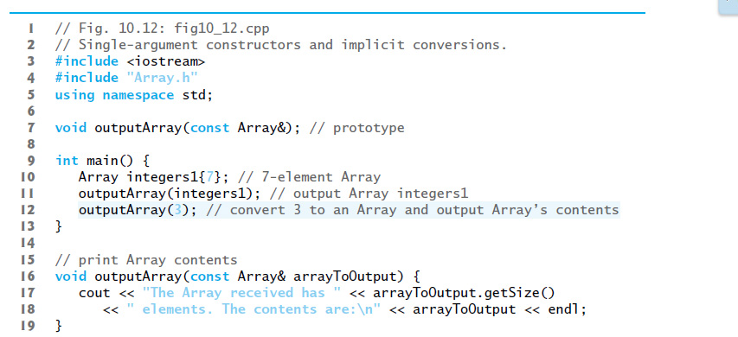
Figure 10.12 Single-Argument Constructors and Implicit Conversions (1 of 2)

Slide 127
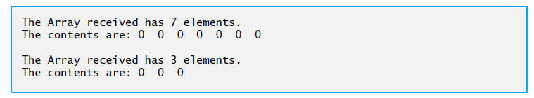
Figure 10.12 Single-Argument Constructors and Implicit Conversions (2 of 2)

Slide 128
10.13 explicit Constructors and Conversion Operators (3 of 5)
Preventing Implicit Conversions with Single-Argument Constructors
The reason we’ve been declaring every single-argument constructor preceded by the keyword explicit is to suppress implicit conversions via conversion constructors when such conversions should not be allowed.
A constructor that is declared explicit cannot be used in an implicit conversion.
In the example if Figure 10.13, we use the original version of Array.h from Figure 10.10, which included the keyword explicit in the declaration of the single-argument constructor in line 13.

Slide 129
10.13 explicit Constructors and Conversion Operators (4 of 5)
Figure 10.13 presents a slightly modified version of the program in Figure 10.12.
When this program is compiled, the compiler produces an error message
Line 14 demonstrates how the explicit constructor can be used to create a temporary Array of 3 elements and pass it to function outputArray.

Slide 130
Error-Prevention Tip 10.4
Always use the explicit keyword on single-argument constructors unless they’re intended to be used as conversion constructors.

Slide 131
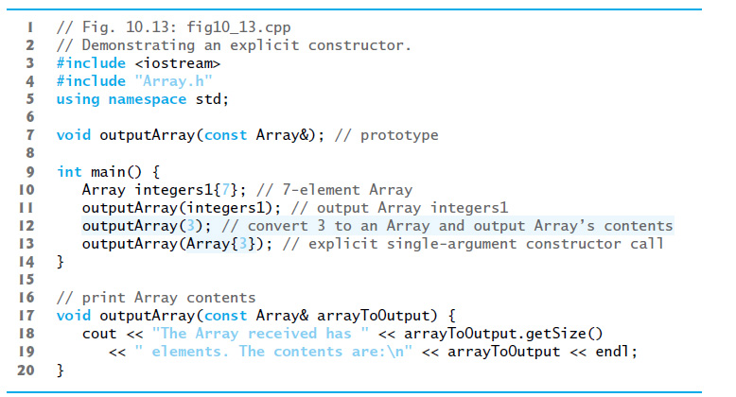
Figure 10.13 Demonstrating an explicit Constructor

Slide 132
10.13 explicit Constructors and Conversion Operators (5 of 5)
C++11: explicit Conversion Operators
Just as you can declare single-argument constructors explicit, you can declare conversion operators explicit to prevent the compiler from using them to perform implicit conversions.
Declares MyClass’s string cast operator explicit.

Slide 133
10.14 Overloading the Function Call Operator () (1 of 3)
Overloading the function call operator () is powerful, because functions can take an arbitrary number of comma-separated parameters.
In a customized String class, for example, you could overload this operator to select a substring from a String—the operator’s two integer parameters could specify the start location and the length of the substring to be selected.
The operator() function could check for such errors as a start location out of range or a negative substring length.
The overloaded function call operator must be a non-static member function and could be defined with the first line:

Slide 134
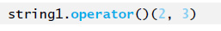
10.14 Overloading the Function Call Operator () (2 of 3)
In this case, it should be a const member function because obtaining a substring should not modify the original String object.
Suppose string1 is a String object containing the string "A E I O U".
When the compiler encounters the expression string1(2, 3), it generates the member-function call

Slide 135
10.14 Overloading the Function Call Operator () (3 of 3)
which returns a String containing "I O U".
Another possible use of the function call operator is to enable an alternate Array subscripting notation.
Instead of using C++’s double-square-bracket notation, such as in chessBoard[row][column], you might prefer to overload the function call operator to enable the notation chessBoard(row, column), where chessBoard is an object of a modified two-dimensional Array class.

Slide 136

Copyright

